Slide 1
SWEN90016 Software Processes & Project Management
SDLC Process
Language Research Case Study
Assignment 1
2019 – Semester 1
Tutorial 2
Copyright University of Melbourne 2017

Slide 2
Today’s aim
Understand the differences between the SDLC and when to use which one

Slide 3
Quiz time
Which of the following are an example of a formal model? Choose all that are correct.
a) V-model
b) Agile
c) Incremental
d) Hybrd
e) Waterfall
from Lecture 2, slide 27

Slide 4
Quiz time
When should you choose a Formal Model?
a) Stable, precise and known requirements
b) Customer gives time to project
c) Mature technologies and tools
d) Client has a prescriptive model established
e) a & c
from Lecture 2, slide 27

Slide 5
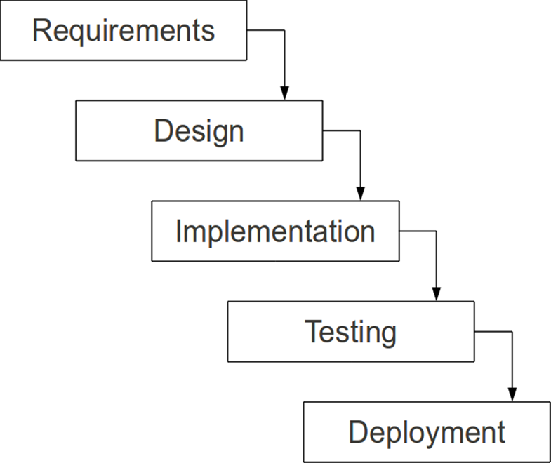
Waterfall
What are the Advantages?
What are the Disadvantages?

Slide 6
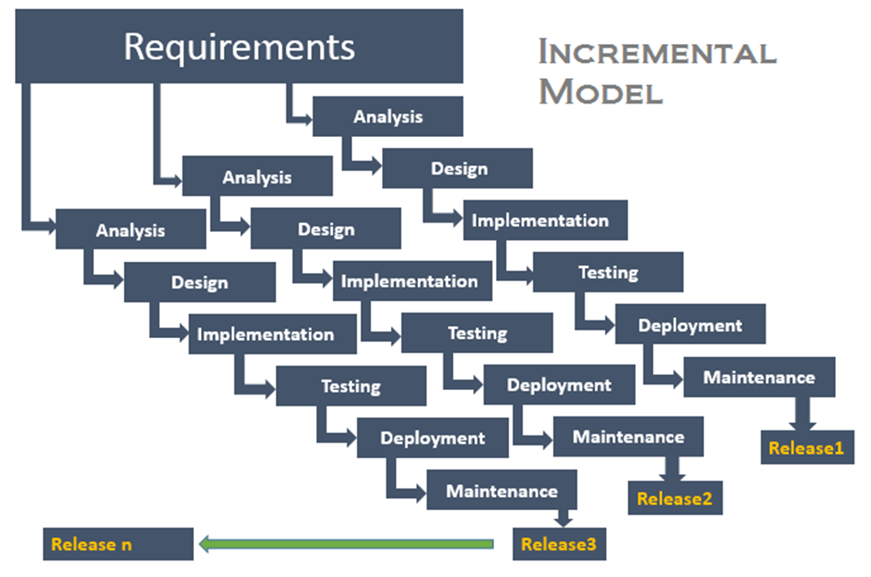
Incremental
Requirement - partition into segments
Releases - mini waterfall process
Integrate modules
What are the Advantages?
What are the Disadvantages?

Slide 7
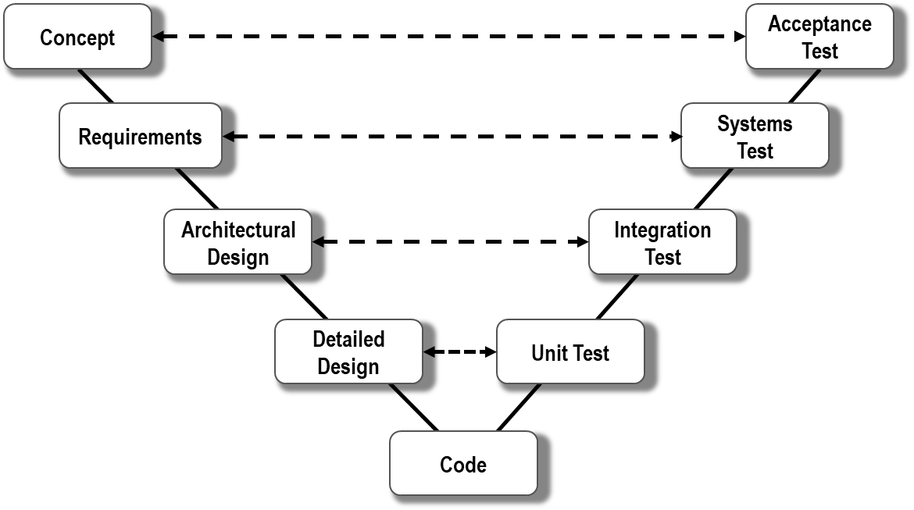
V-Model
waterfall model plus defined artifact deliverable
development stage ← → testing phase
What are the Advantages?
What are the Disadvantages?

Slide 8
Quiz time
When should you choose agile?
a) Requirements continue to emerge
b) Customer gives time to project
c) Mature technologies and tools
d) Change is welcome
e) a & b & d
from Lecture 2, slide 27

Slide 9
Agile
Scrum: method to organize working teams
XP: method to improve code quality
What are the Advantages?
What are the Disadvantages?

Slide 10
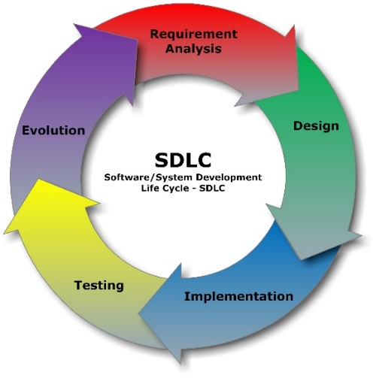
Compare SDLCs
When to choose Formal Models?
When to choose Agile Models?
When to choose a hybrid model?
from Lecture 2, slide 27

Slide 11
Today’s aim
Explore the relationship between projects and processes
Discuss in small groups and share ideas.

Slide 12
Planning Phase
The second Project Management process: planning
from Lecture 2, slide 16 & 17
Approach:
team resources & structure,
project goals & characteristics
Processes:
formal or agile SDLC phases
Activities:
Formal: Requirements Analysis, or
Agile: Groom Product Backlog
Decompose the plan!
marks given in assignment when you identify the SDLC phase names and specify which activities belong in this phase
Tools:
hardware, operating system
programming languages, libraries,
network, ecosystem, IDEs

Slide 13
Case Study Analysis
Case Study 2 –Language Research Tool Project
Determine the goals & key characteristics
Goal
Key Characteristics

Slide 14
Case Study Analysis
Case Study 2 –Language Research Tool Project
What are the challenges and risks?
Challenges: what would make this project difficult?
Risks: what could make this project fail?

Slide 15
Project Analysis
In groups of 4, discuss SDLC processes & activities
Consider the project, people & technology
Evaluate the team and project constraints.
Evaluate multiple SDLC models
Identify the advantages and disadvantages
Consider the outcomes and risks
Justify an effective SDLC process
Defend your choice of SDLC
List the activities done
Formal: Requirements Specification
Agile: Product Backlog

Slide 16
Assignment 1
Due: Friday, 5th April 2019
Marks: 20%
What: Figure out an appropriate SDLC for a given Case Study
How to do well:
Critical analysis of Case Study characteristics and risks
Critical analysis of each SDLC’s processes
Balance the pros and cons and justify your choice of SDLC
Any Questions?
next tutorial: Agile Scrum SDLC

Slide 17
Thank You!

